Slide 1
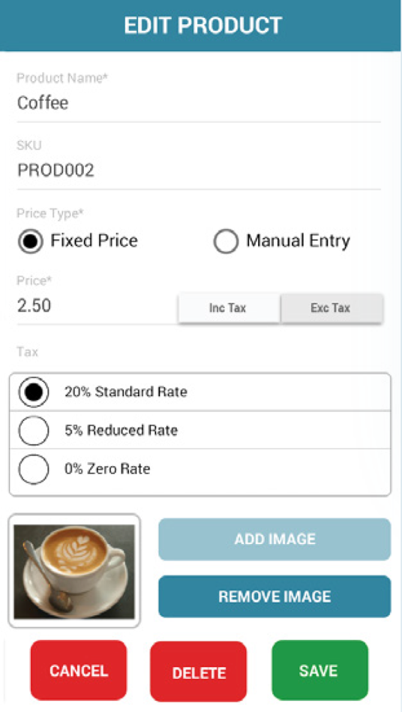
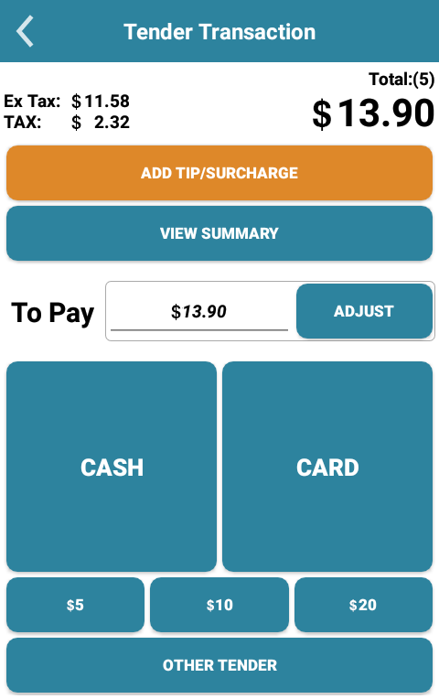
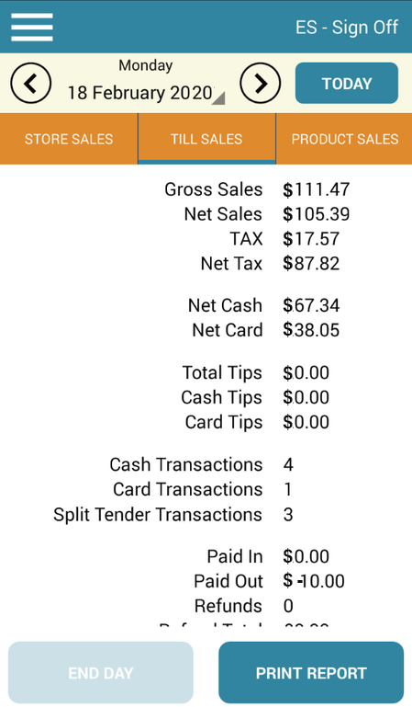
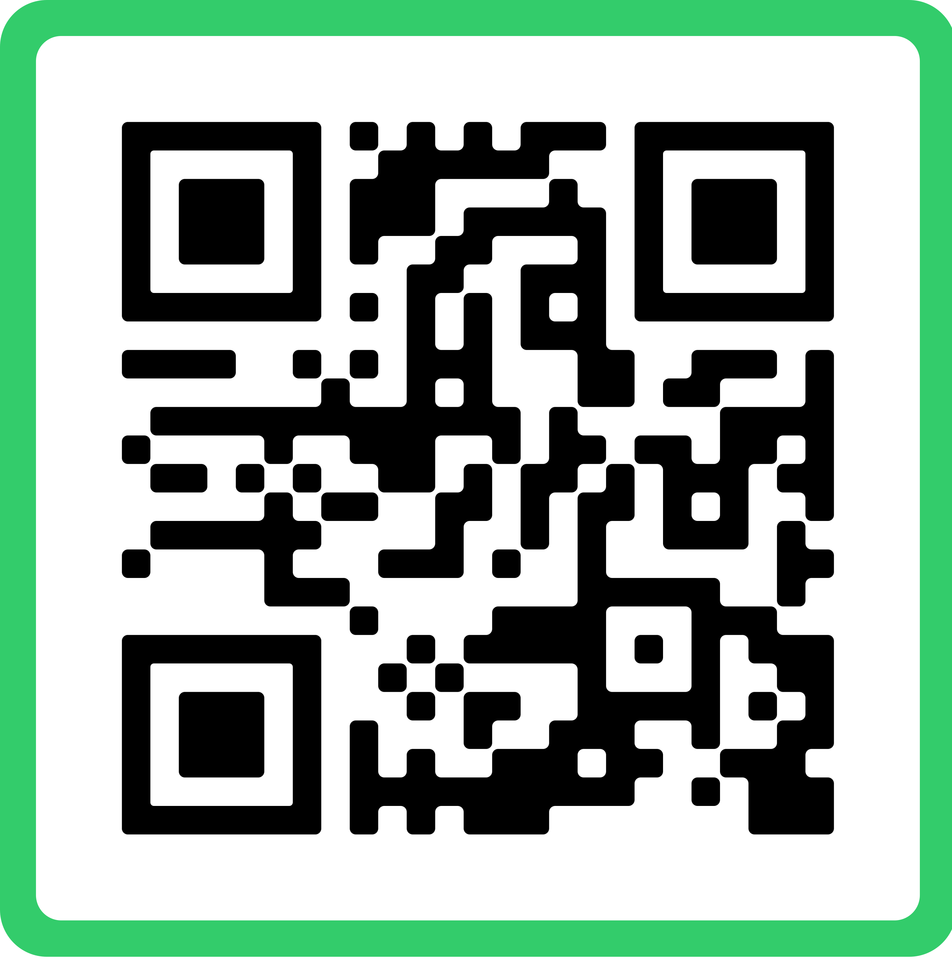

The all-in-one
Android Starter Pack
Simple, Fast, Modern
1. Android POS Device
Offer entry level, ready-to-go merchant solutions by combing payment acceptance and light business enablement in
a highly integrated, compact way.
7” handheld terminal
WIFI, Bluetooth, 4G, USB-C
Magnetic Stripe, EMV
Chip/ NFC
Easy to use POS setup
Easy Activation
Simple Inventory Setup
Manage
2. Robust payment app
Credit
Debit
EBT
Cash Back
3. Easy to use POS App
Scan
Pay
Report
ePOS
Interested?
Get in touch
Phone: +x xxxxx
Email: info@isoname.com
Scan for more info

Slide 2

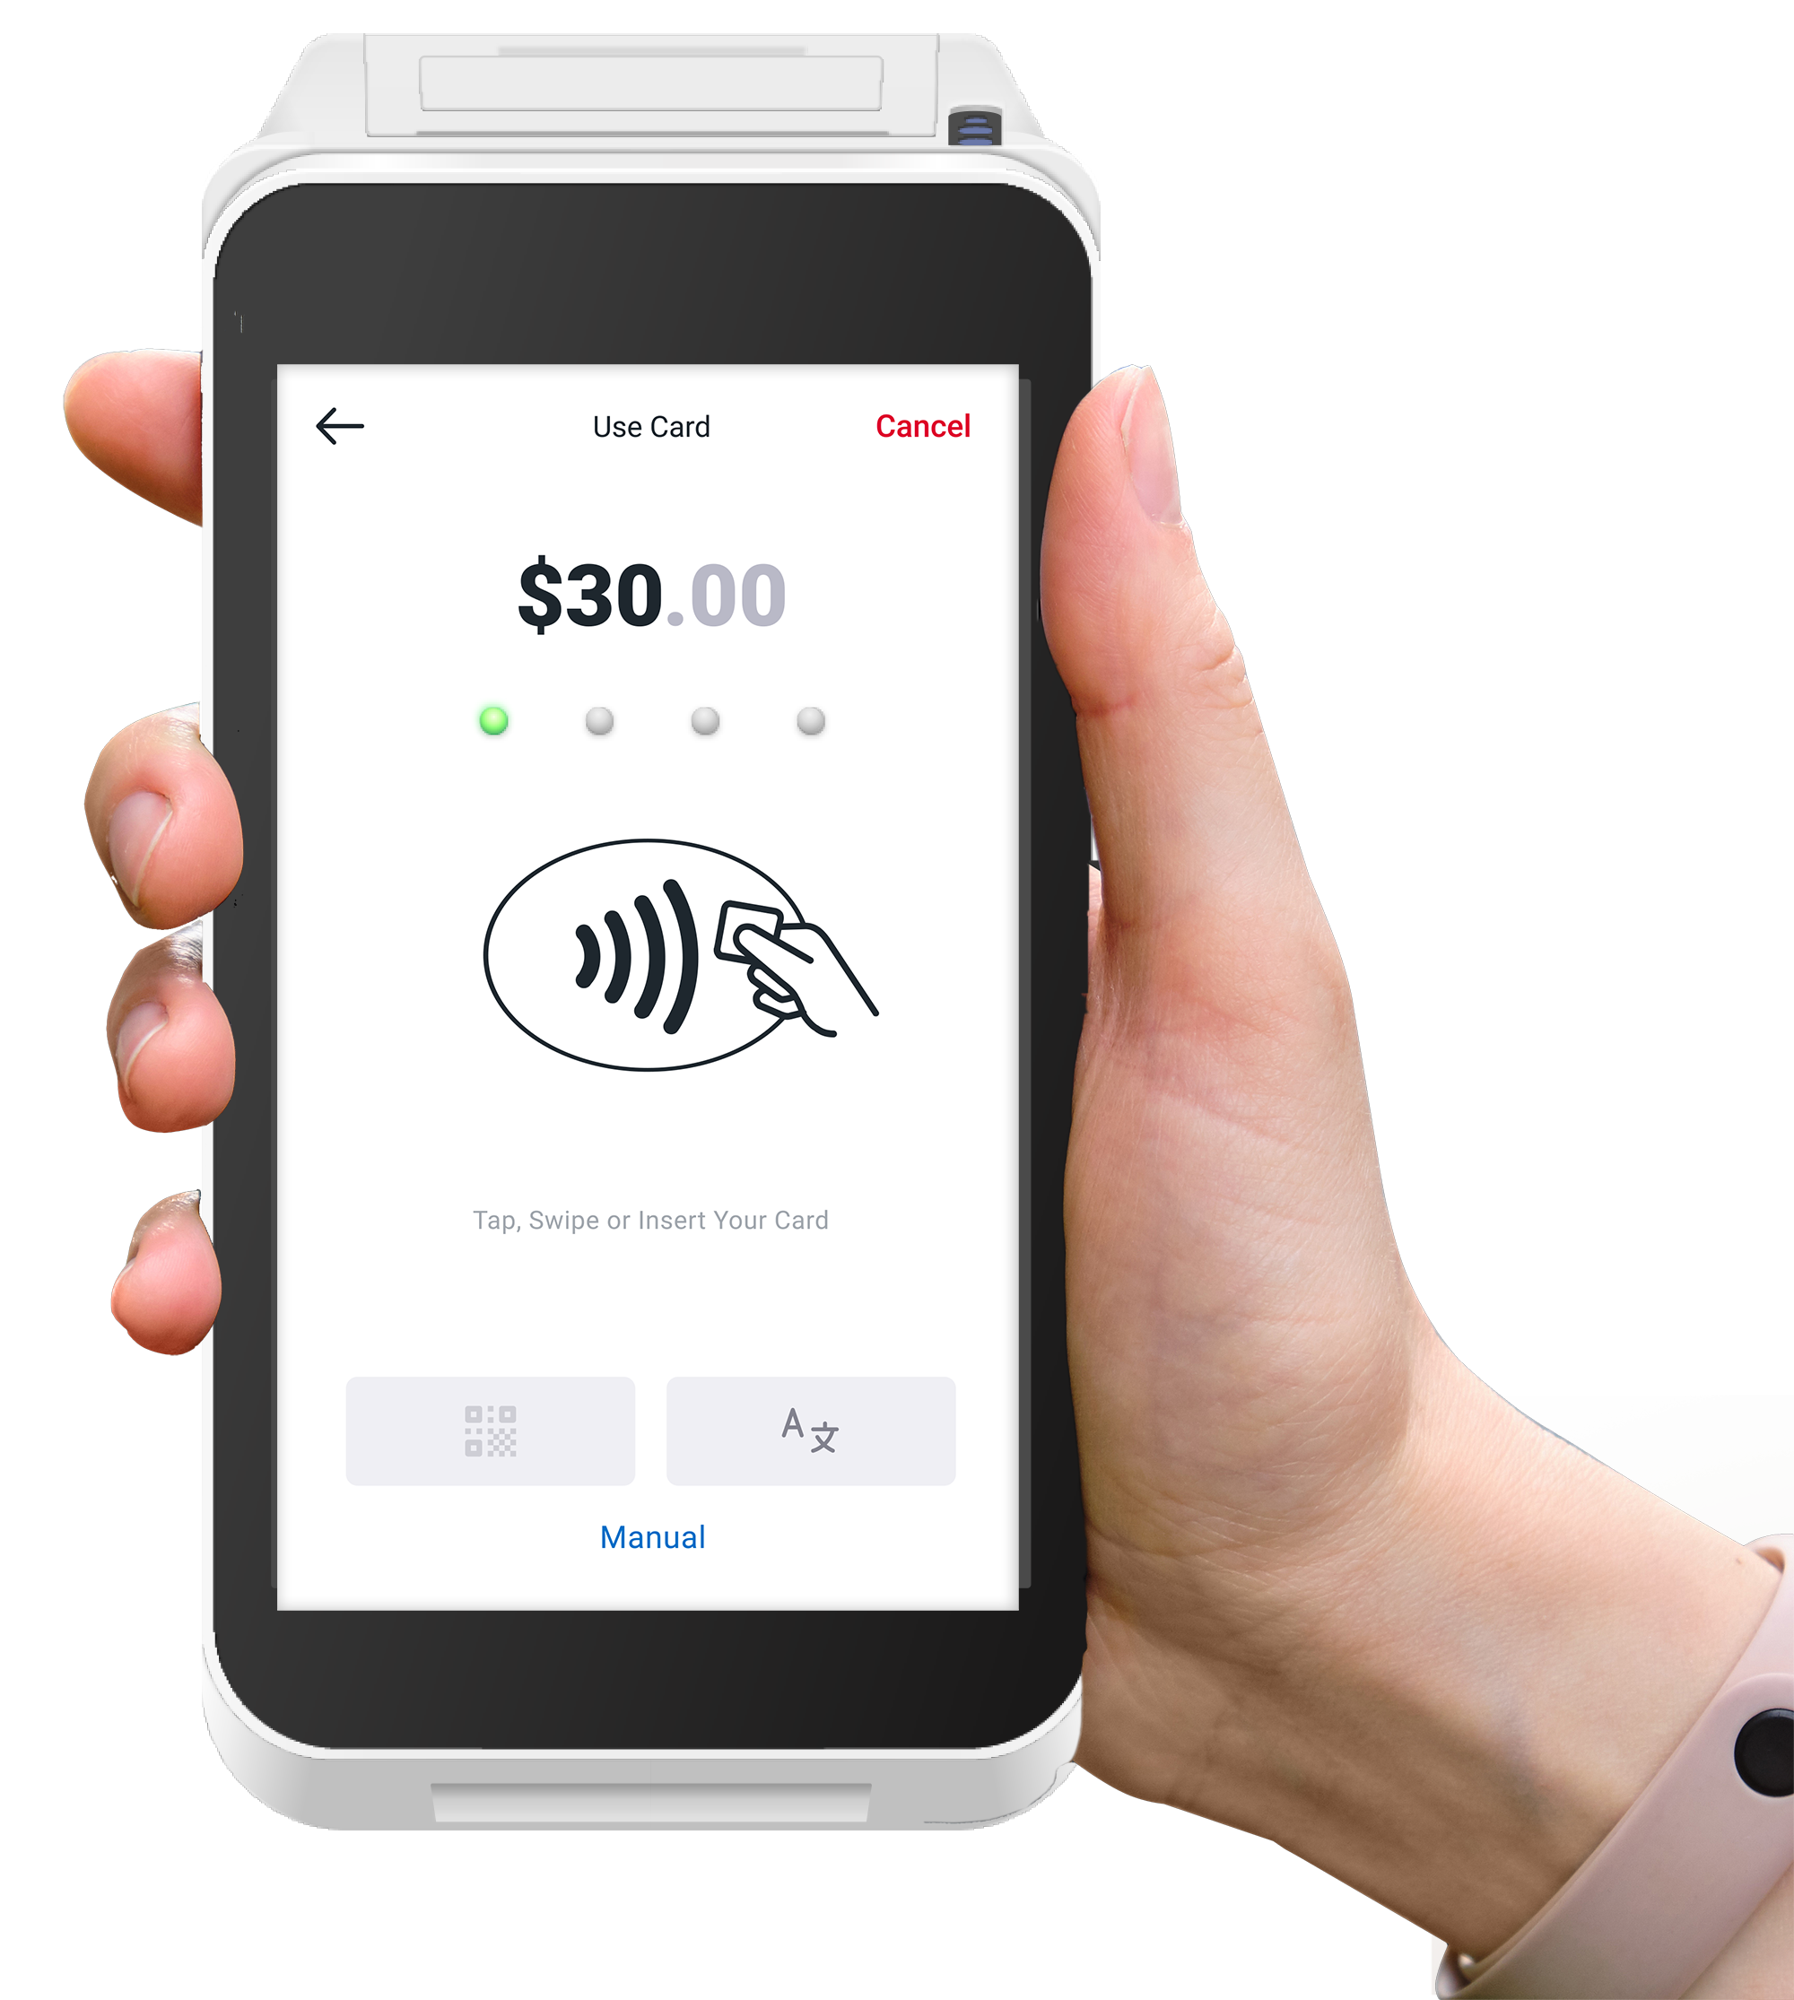
Café:
Quick & easy payments
Setup for success that leads to higher profits
Increase sales and improve service with quicker payments​
Manage orders with order numbers or tabs (or both)​​
Print orders with order numbers
​
Use modifiers to customize orders
Tip functionality
​
Send email receipts to your customers
​Manage shifts and adapt inventory

Slide 3

Food truck:
Quick & easy payments
Setup for success that leads to higher profits
Operate your food truck from an all-in-one ​handheld device​
Manage orders with order numbers or tabs (or both)​​
Use modifiers to customize orders​​
Activate tip functionality​ Send email receipts to your customers​ ​
View 40+ real-time business reports via​ the web portal

Slide 4

Boutique:
Optimised checkout experience
Setup for success that leads to higher profits
Easily manage card and cash payments​
Increase your customer engagement -> provide customers with notifications and offerings
Manage your products, services and ​taxes instantly​
Send email receipts to your customers
​View real-time business reports via​ the web portal

Slide 5

Hair & Beauty:
Better relationships
Setup for success that leads to higher profits
Check your inventory
Cash Management
Operates Offline
Product Management
Web Portal

Slide 6

Pet Care:
First-class customer service
Setup for success that leads to higher profits
Easily check inventory
Product Management
Back Office Portal
Integrated Card Payment
Web Portal

